Slide 1
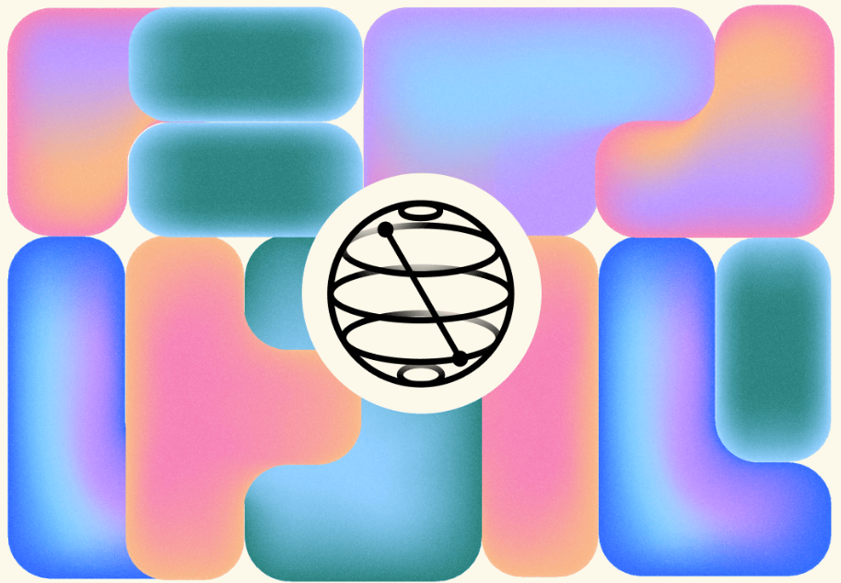
IBM Quantum Composer
Kevin J. Joven
Qiskit Fall Fest
October 23, 2023
IBM Quantum
Qiskit Composer
October 24, 2023
1/13

Slide 2
What is IBM Quantum Composer?
IBM Quantum
Qiskit Composer
October 24, 2023
2/13

Slide 3
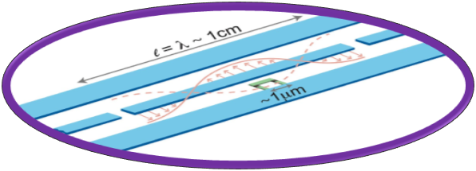
What is IBM Quantum Composer?
Microwave Electronics and cQED
IBM Quantum
Qiskit Composer
October 24, 2023
2/13

Slide 4
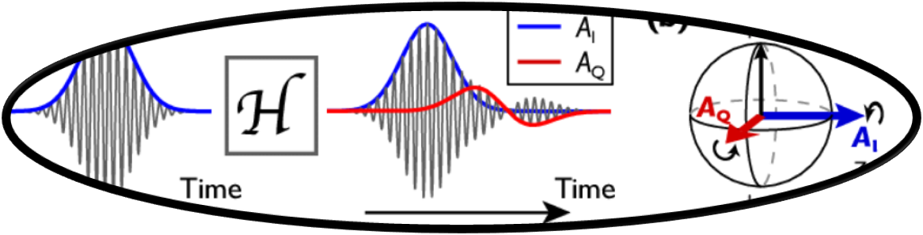
What is IBM Quantum Composer?
Qiskit Pulse and Transpile
Microwave Electronics and cQED
IBM Quantum
Qiskit Composer
October 24, 2023
2/13

Slide 5
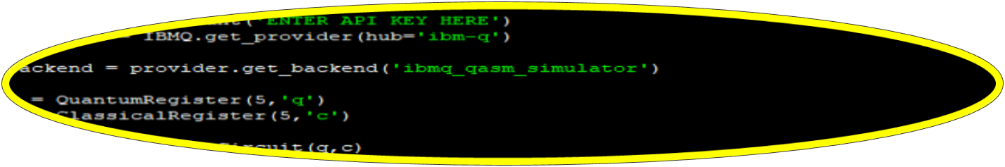
What is IBM Quantum Composer?
Qiskit Programming
Qiskit Pulse and Transpile
Microwave Electronics and cQED
IBM Quantum
Qiskit Composer
October 24, 2023
2/13

Slide 6
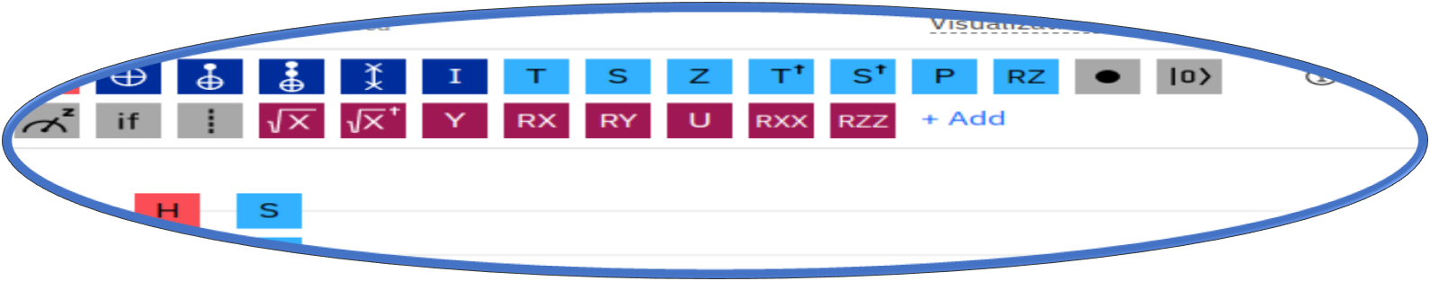
What is IBM Quantum Composer?
Qiskit Composer
Qiskit Programming
Qiskit Pulse and Transpile
Microwave Electronics and cQED
IBM Quantum
Qiskit Composer
October 24, 2023
2/13

Slide 7
How It looks like?
IBM Quantum
Qiskit Composer
October 24, 2023
3/13

Slide 8
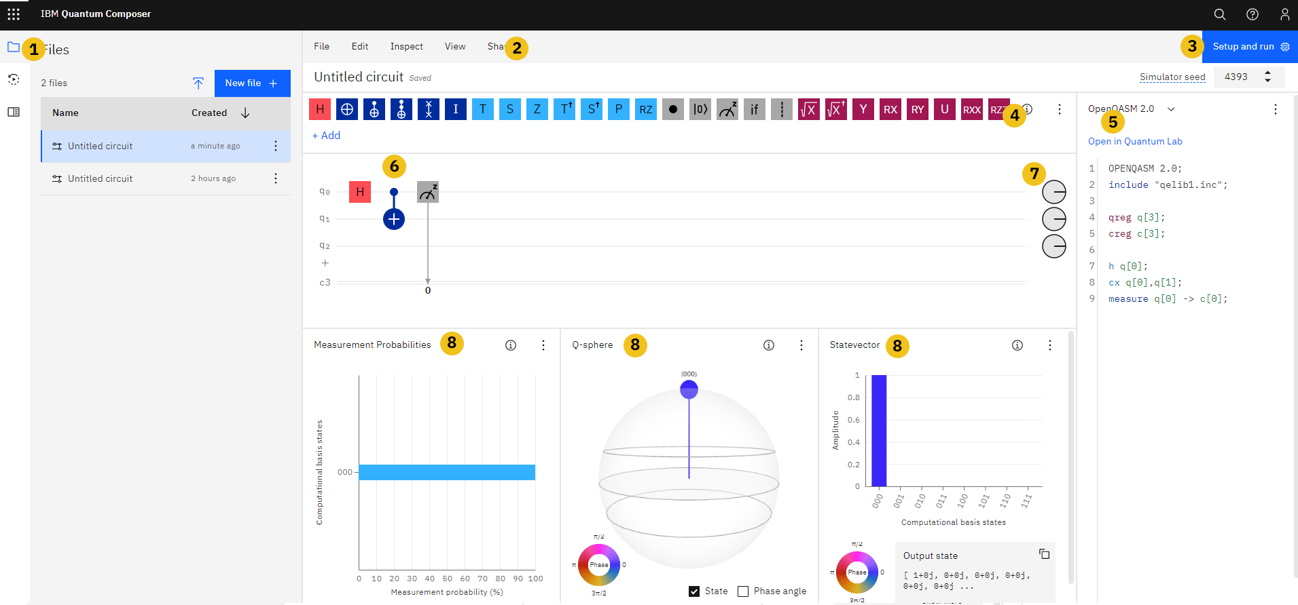

Slide 9
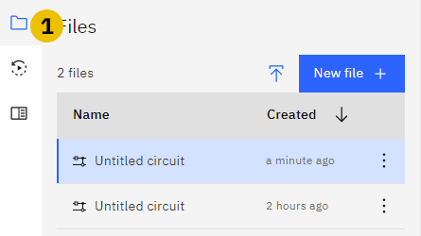


Divide and conquer
Tools Panel
Menu
Execution
IBM Quantum
Qiskit Composer
October 24, 2023
4/13

Slide 10
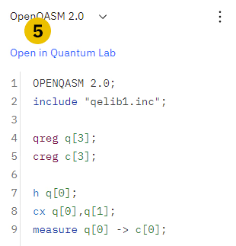
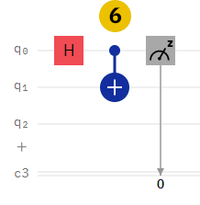

Divide and conquer
Quantum Gates
Code Output
Quantum Circuit
Final State
IBM Quantum
Qiskit Composer
October 24, 2023
5/13

Slide 11
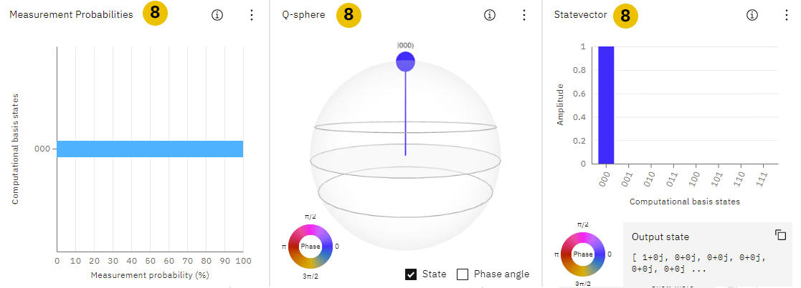
Divide and conquer
Visualization
IBM Quantum
Qiskit Composer
October 24, 2023
6/13

Slide 12
What I need?
IBM Quantum account: https://quantum-computing.ibm.com/
Go to learning resources.
Open IBM Quantum Composer.
Start programming.
IBM Quantum
Qiskit Composer
October 24, 2023
7/13

Slide 13
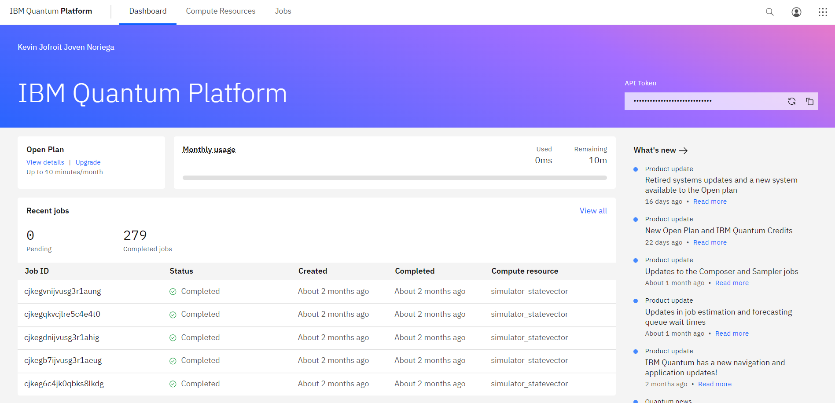
What I need?
IBM Quantum
Qiskit Composer
October 24, 2023
8/13

Slide 14
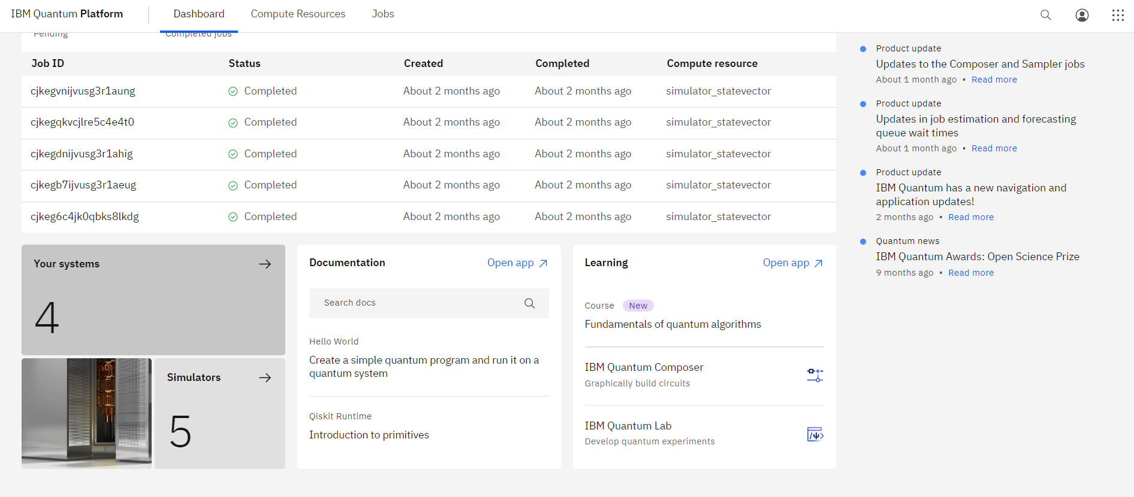
What I need?
IBM Quantum
Qiskit Composer
October 24, 2023
9/13

Slide 15
What I need?
IBM Quantum
Qiskit Composer
October 24, 2023
9/13

Slide 16
Let’s test it
IBM Quantum
Qiskit Composer
October 24, 2023
10/13

Slide 17
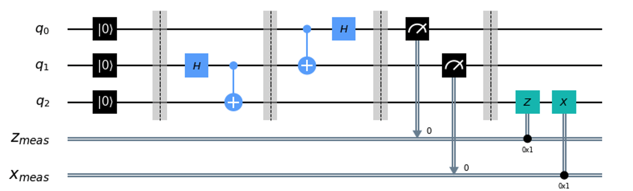
Let’s test it
IBM Quantum
Qiskit Composer
October 24, 2023
10/13

Slide 18
Let’s test it
Quantum Teleportation
IBM Quantum
Qiskit Composer
October 24, 2023
10/13

Slide 19
Let’s test it
Entanglement
No cloning theorem
Quantum Circuits
Reversibility
Quantum states
Post-measurements
IBM Quantum
Qiskit Composer
October 24, 2023
10/13

Slide 20
Let’s test it
IBM Quantum
Qiskit Composer
October 24, 2023
11/13

Slide 21
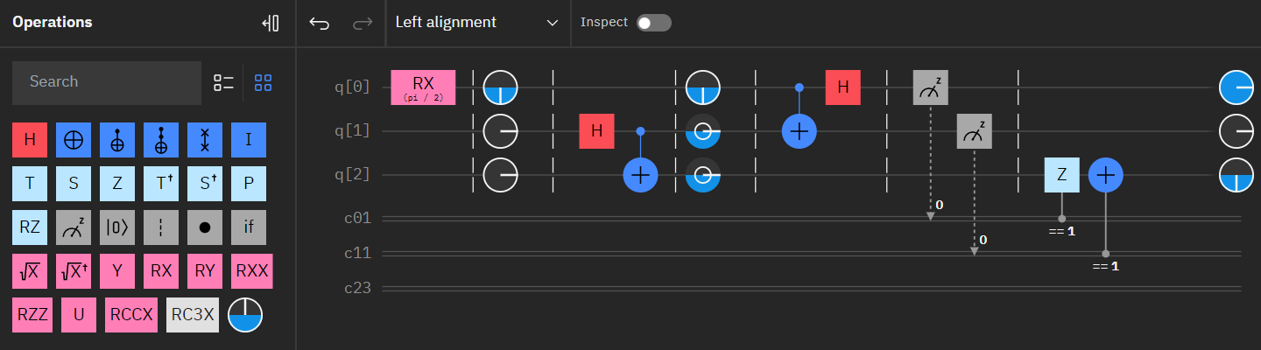
Let’s test it
IBM Quantum
Qiskit Composer
October 24, 2023
11/13

Slide 22
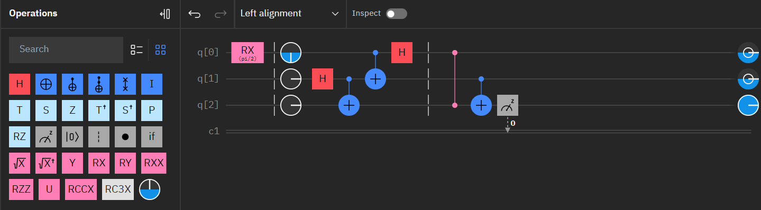
Let’s test it
IBM Quantum
Qiskit Composer
October 24, 2023
11/13

Slide 23
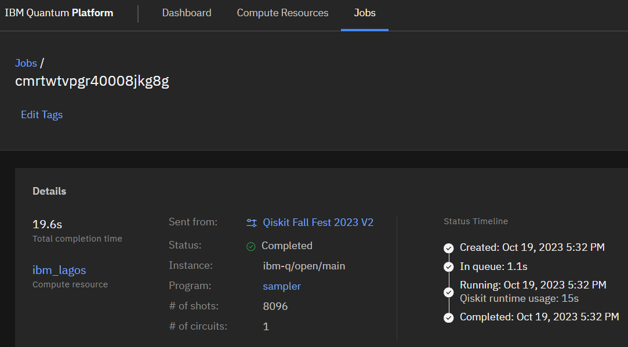
Let’s test it
IBM Quantum
Qiskit Composer
October 24, 2023
11/13

Slide 24
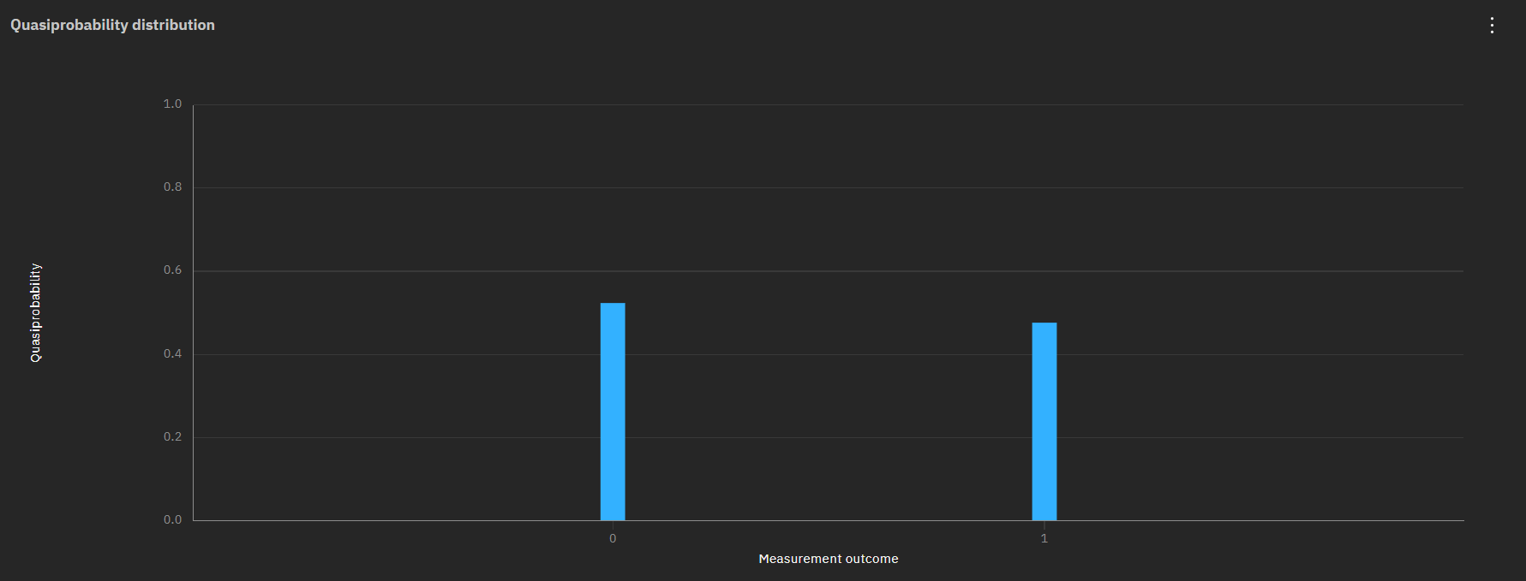
Let’s test it
IBM Quantum
Qiskit Composer
October 24, 2023
11/13

Slide 25
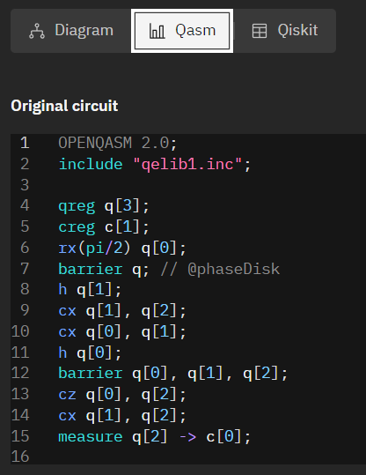
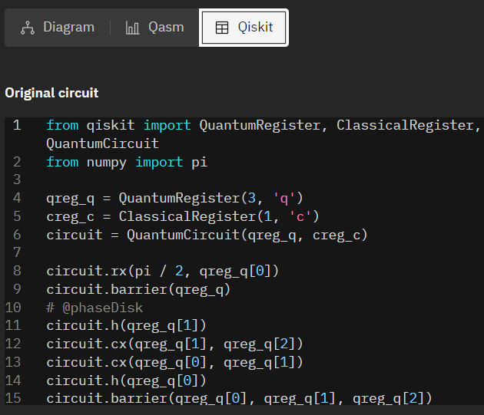
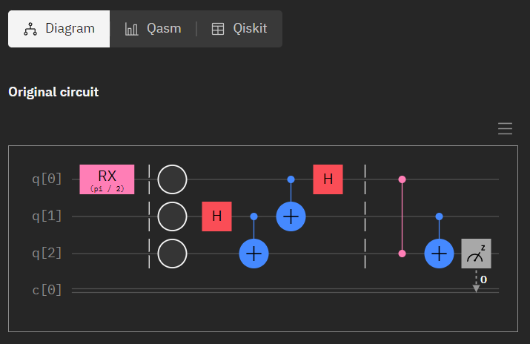
Let’s test it
IBM Quantum
Qiskit Composer
October 24, 2023
11/13

Slide 26
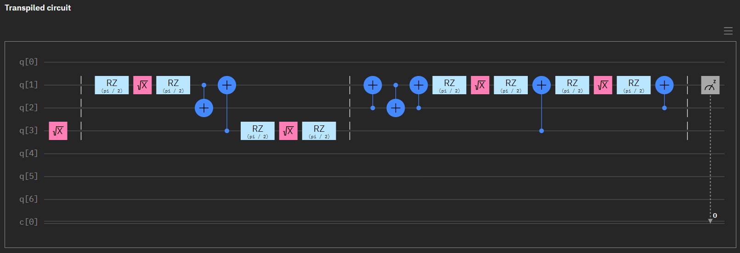
Let’s test it
IBM Quantum
Qiskit Composer
October 24, 2023
11/13

Slide 27
Thanks!
THANKS!
IBM Quantum
Qiskit Composer
October 24, 2023
12/13

Slide 28
References
[1] IBM Quantum: https://quantum-computing.ibm.com/
[2] Qiskit Documentation: https://qiskit.org/documentation/stable/0.25/qc_intro.html
[3] Quantum Teleportation with Qiskit: https://www.youtube.com/watch?v=mMwovHK2NrE
[4] Quantum Composer: https://learning.quantum-computing.ibm.com/tutorial/composer-user-guide
IBM Quantum
Qiskit Composer
October 24, 2023
13/13

